Slide 1
Data Visualization
Top 250 Movies of All Time
Zola Welch and Victoria Julian

Slide 2
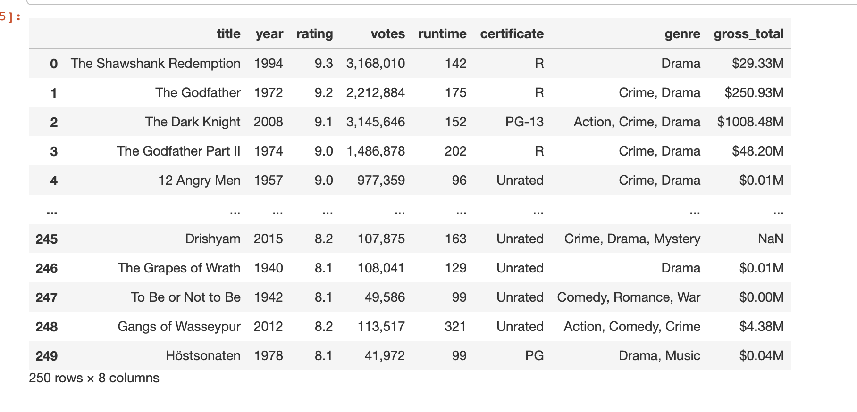
Introduction
This dataset lists 250 "Top Films of all Time" in order of ranking.
Numerical Columns: Year, Rating, Runtime
Categorical Columns: Title, Votes, Certificate, Gross Total, Genre
250 rows and 8 columns

Slide 3
Data Selection + Wrangling
We found this dataset on Kaggle an open-source data site. After our preliminary scan of the data, we found that there was four missing values in the gross total column. To clean that up we used fill in with mode to help us. Another way we cleaned up the data was by categorizes the movies by decade instead of individual release year. This made it easier to create visualizations-based on year.

Slide 4
Research Question + Why we chose this data set
Does movie rating (G, PG, PG-13, and R) and runtime impact popularity?
We chose this data set because both our main personal hobbies are movies, so this is interesting to us. This dataset includes the year released, rating, genre, length, etc. We are going to look for patterns, focusing on whether the genre of the movie affects the popularity.

Slide 5
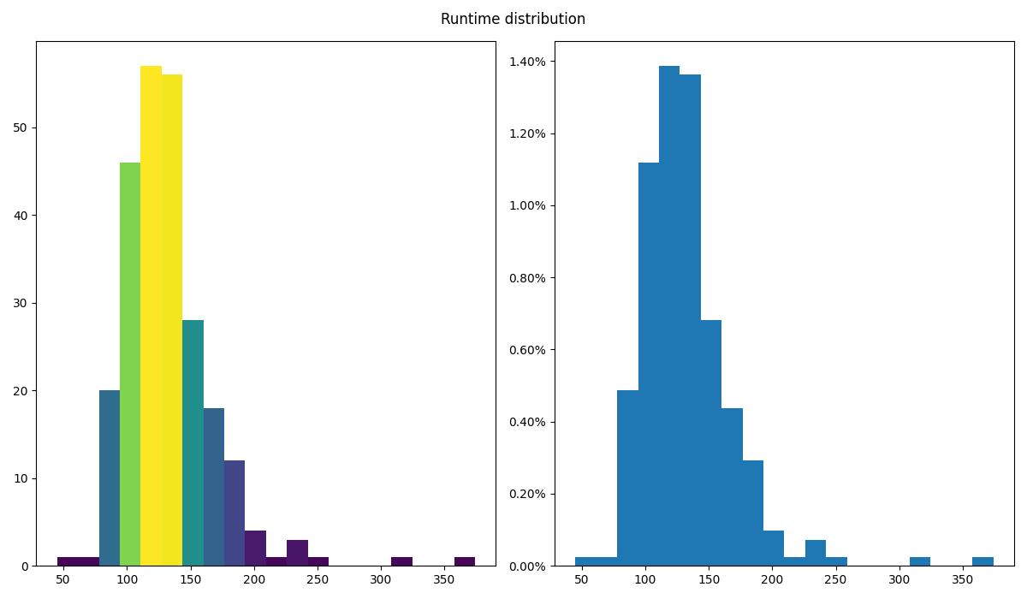
Histogram of the movies' runtime
This graph shows us that overwhelmingly, the top 250 movies have an average runtime between 100 and 150, but there is two major outliers one between 300-350 minutes and another over 350 minutes.
This means that if your movies is between 100 and 150 minutes it has a better chance of becoming one of the top 250 movies of all time.

Slide 6
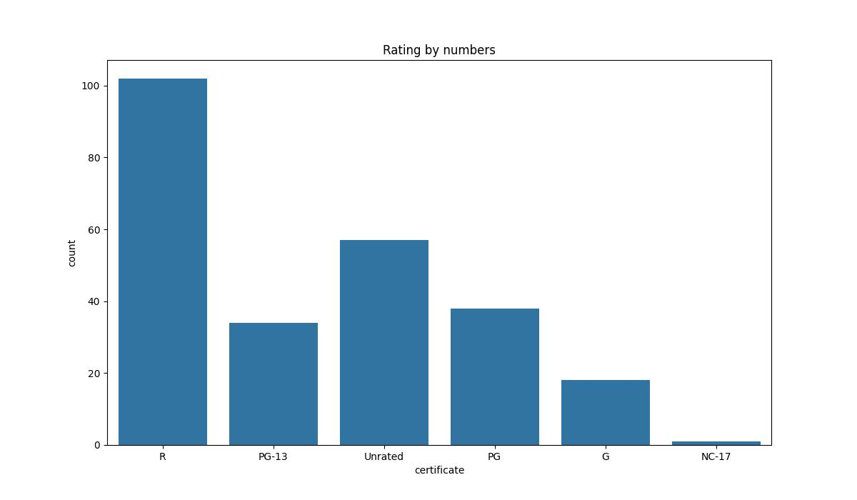
What is the most popular content rating?
Based on this count plot we can see that movies rated R have the highest amount on this list. This suggests that movie viewers enjoy more graphic subject matter.

Slide 7
Insights
Originally our question was "Does movie genre impact popularity?" but we changed the question because the data set made the original variable 'Genre' difficult to analyse. This is because there were so many values and a lot of them were repeated. From the data, and the visualizations that we created, we gathered that both the movie rating and the runtime can affect movie popularity, even though tehre are a few outliers in the dataset, the overall trend is the same.

Slide 8
Thank You

